Slide 1
hOW CAN STEM EDUCATION TRANSFORM THE ENVIRONMENT OF TOMORROW

Slide 2
“Nothing in life is to be feared. It is only to be understood.”
Marie Curie
STEM – interdisciplinary approach to learning where rigorous academic concepts are coupled with real-world lessons as students apply science, technology, engineering, and mathematics in contexts that make connections between school, community, work, and the global enterprise.

Slide 3
Along with preparing students for future careers, STEM education also teaches students skills that can transcend into all areas of their lives.
STEM teaches our students how to apply their science understanding to solving problems that are relevant and important in their lives and in the world. It also helps develop critical-thinking and problem-solving skills.

Slide 4
ENVIRONMENT PROTECTION
Is a science that studies man’s relationship with the environment.
Builds the scientific base for a waste - free process of production for a more rational use of natural resources

Slide 5
the role of stem disciplines in environmental protection
Currently, environmental protection is considered to be a complex scientific discipline which establishes the principles and methods of conserving and regenerating natural resources.
Interdisciplinary science
The experts must be able to build complex scenarios to inspire technological innovation

Slide 6
MAThEMATICs
In the debate regarding renewable resources math brings solid scientific arguments providing trust in the models and climate change simulations.
Helps improve existing technologies
Key in evaluating renewable resources based on observation
.

Slide 7
physics
Offers the base for understanding the dynamic interactions between the atmosphere and the oceans; it is also instrumental in the study of weather and climate change
A significant part of physics is the study of energy and, as we know, energy is right at the center of all environment related problems
The relationship between the oceans and the atmosphere, monitoring and improving the environment and the production of sustainable energy are 3 aspects where the role of physics is fundamental.

Slide 8
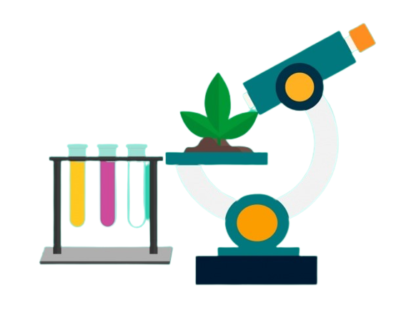
biology
Is a science of life; it speaks about the relationship between living organisms and their environment
It helps stimulate a positive attitude towards the environment
Key to a healthy biosphere, where all elements, biotics and abiotics, have a balanced interaction.
Ecology is an essential part in the study of biology.

Slide 9
chemistry
Develops instruments and techniques to measure air and water pollution
Essential in understanding how the climate has changed over time
In order to understand and study the impact of different chemical substances on the environment we need to analyze the way they behave in the lab and outside of it

Slide 10
STEM Education
Raises Awareness
Teaches Us How To Protect Our Habitat
Can Help Minimize Environmental Issues

