Slide 1




Climate Change
Impact on local communities

Slide 2
What is climate change?
Climate change is a long-term change in the average weather patterns
that have come to define Earth's local, regional and global climates.
Global temperatures rose about 1.1°C from 1901 to 2020,
but climate change refers to more than an increase in temperature.
When you hear climate change what is the first thing that comes
into your mind?

Slide 3
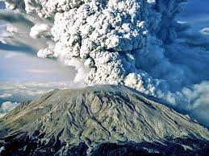
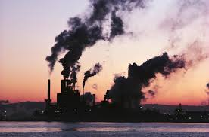
What is the cause of climate change?
https://www.youtube.com/watch?v=G4H1N_yXBiA
Natural causes
Human causes

Slide 4
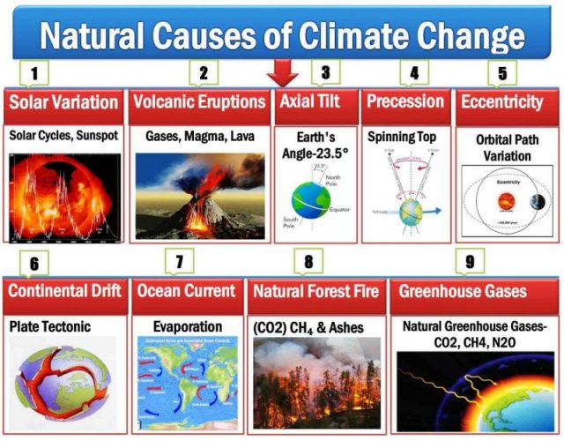
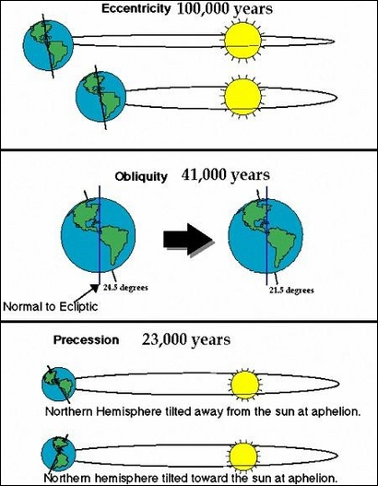
Natural causes

Slide 5
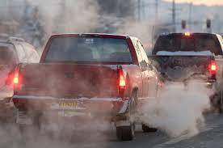
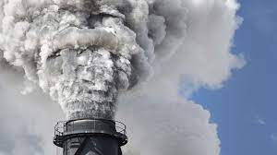
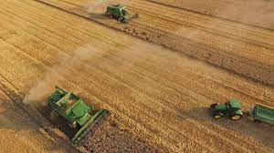
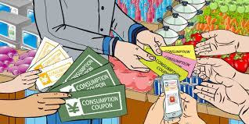
Human Causes
How do we get to
greenhouse gas
emissions?

Slide 6
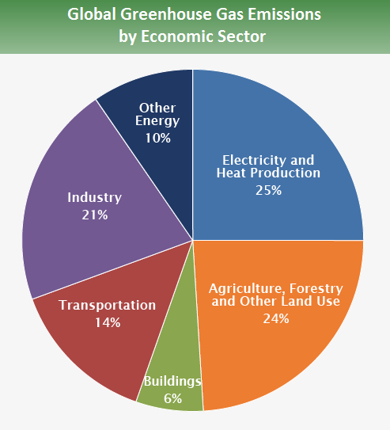

Slide 7
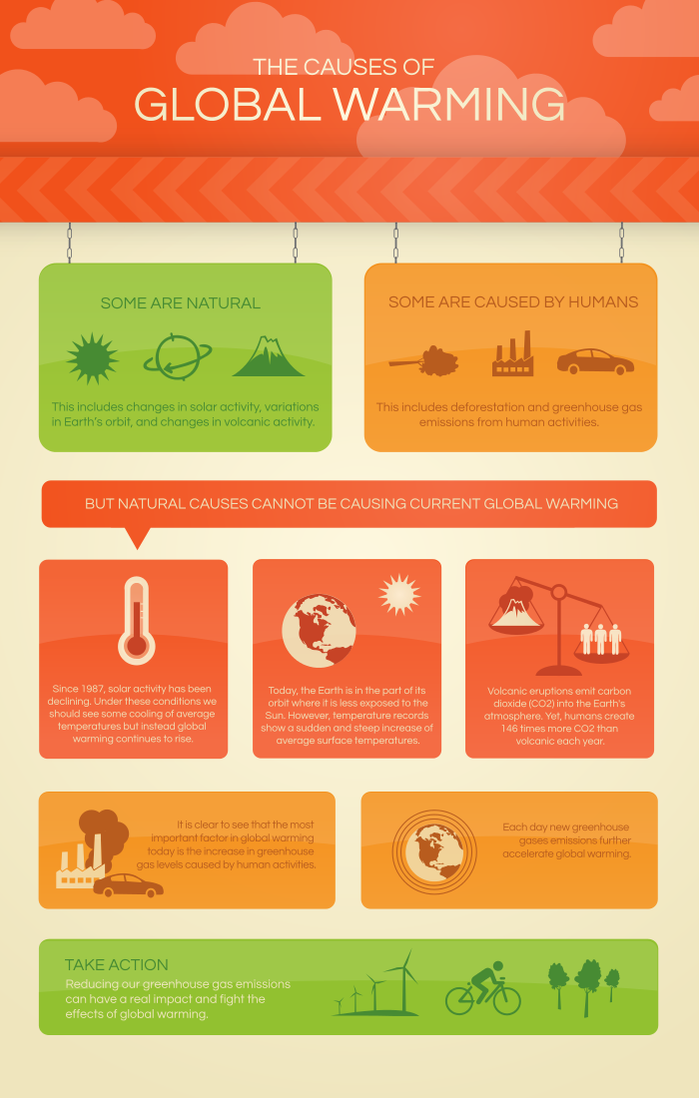
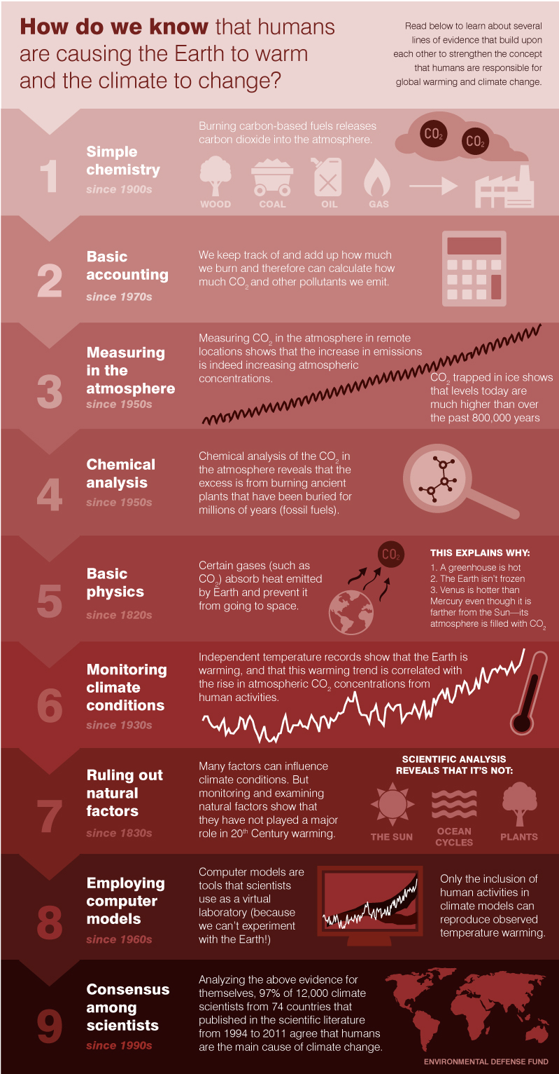

Slide 8
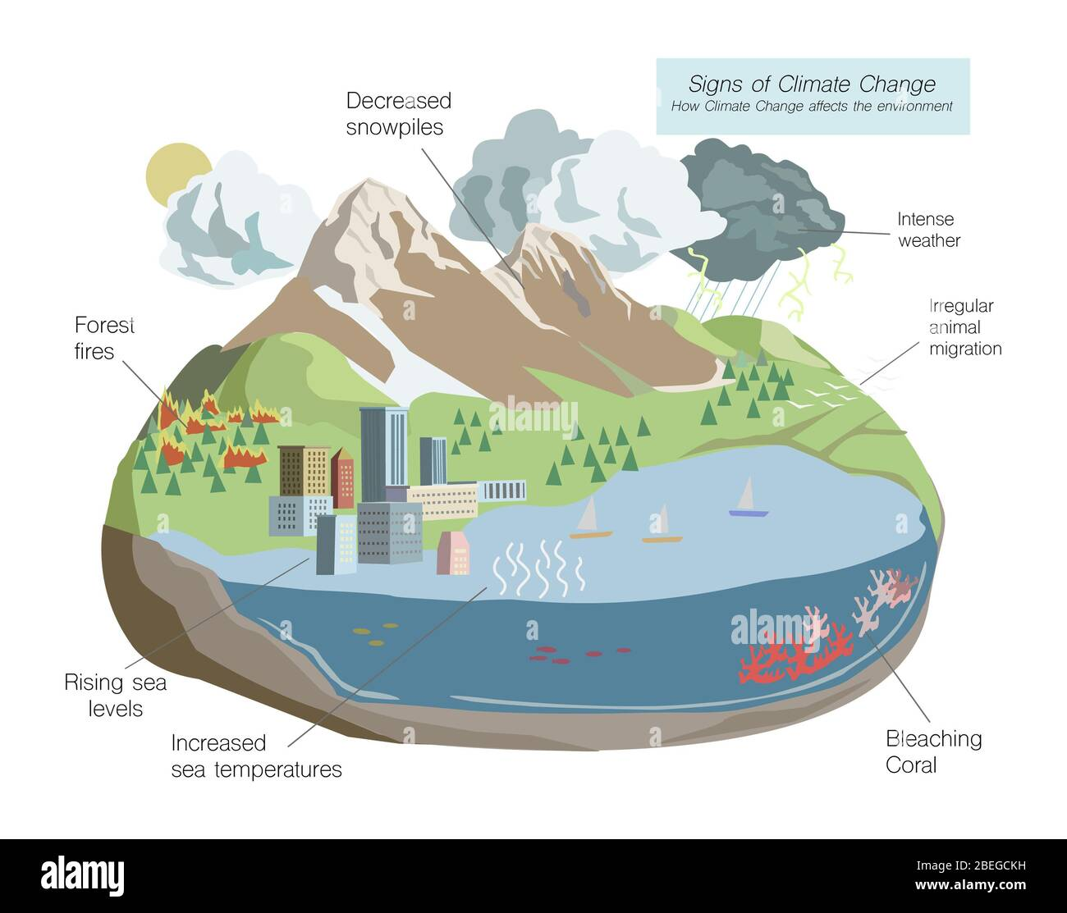
What are
the effects?

Slide 9
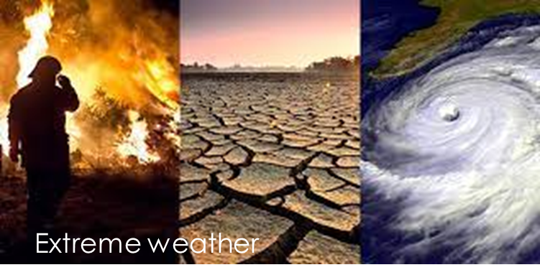
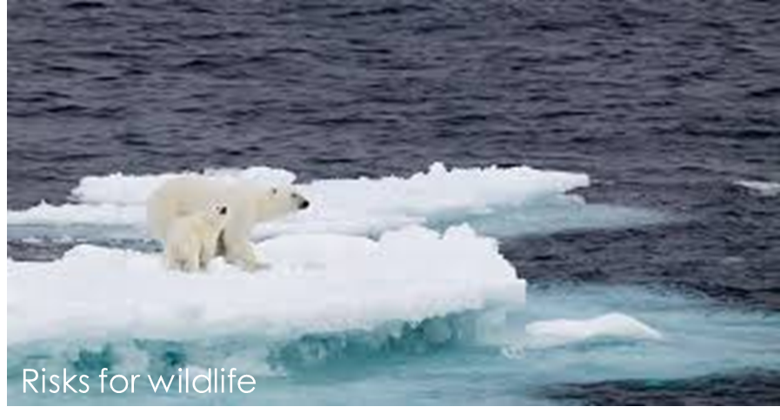
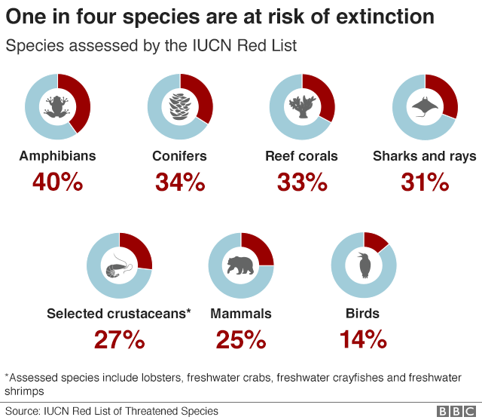
Do you have examples?

Slide 10
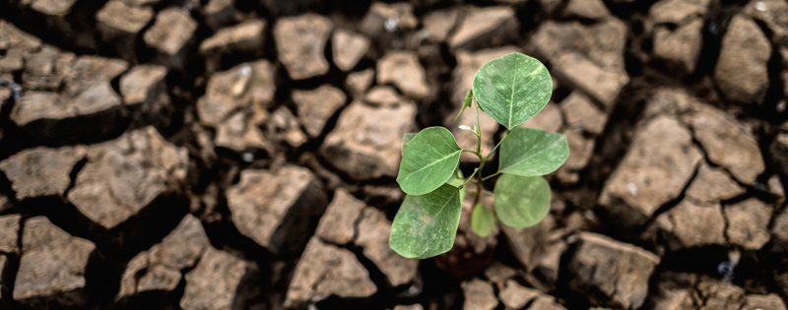
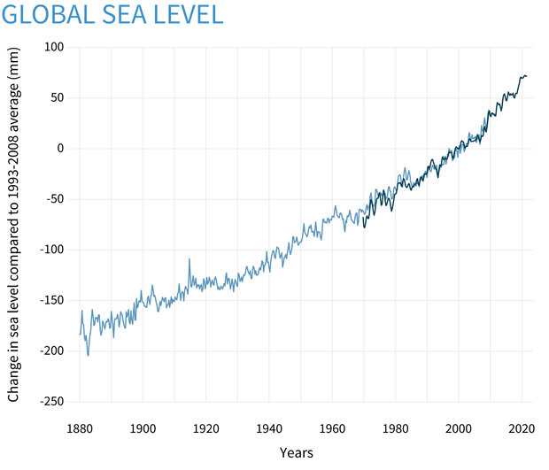
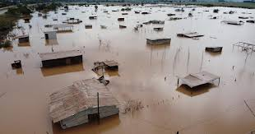
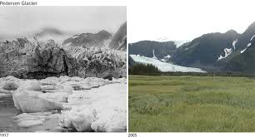
Food insecurity
Human health and home loss
Melting ice and rising sea level

Slide 11
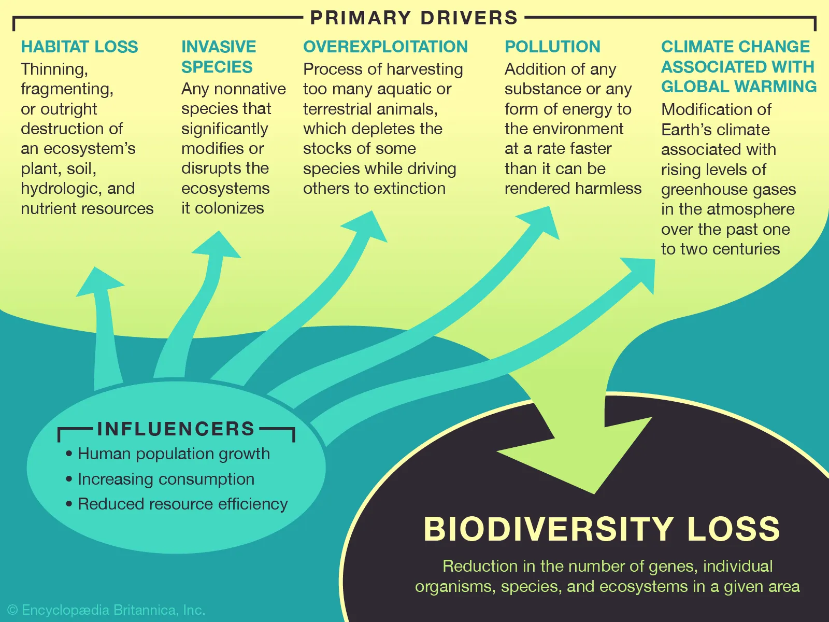
Biodiversity loss

Slide 12
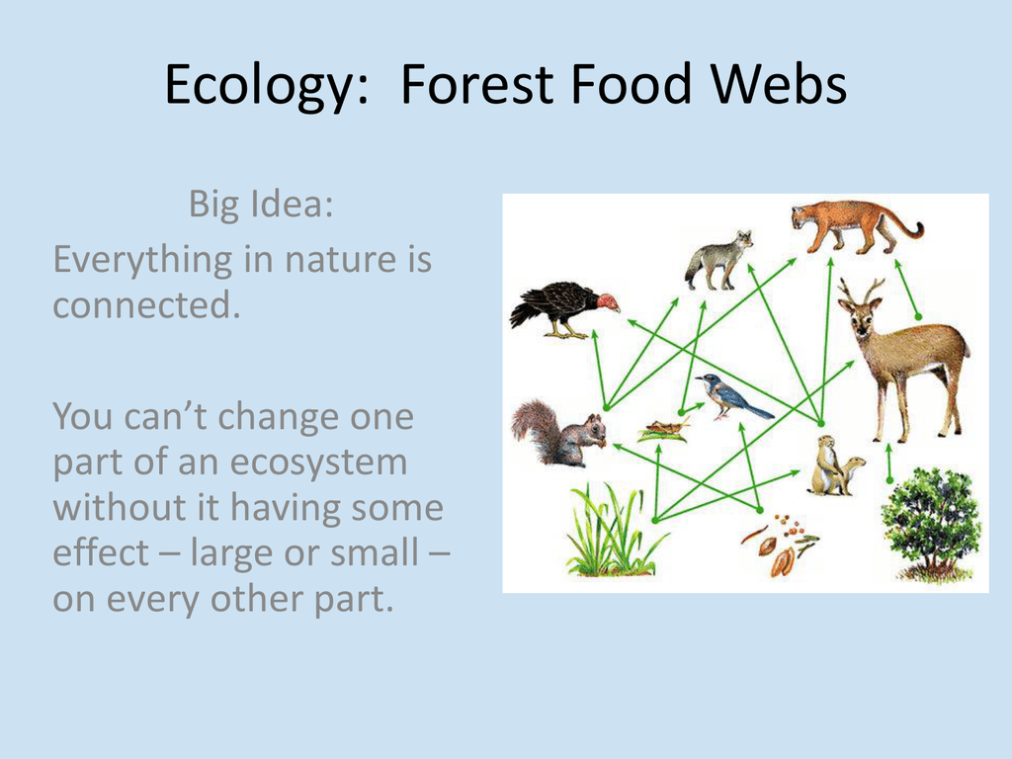

Slide 13
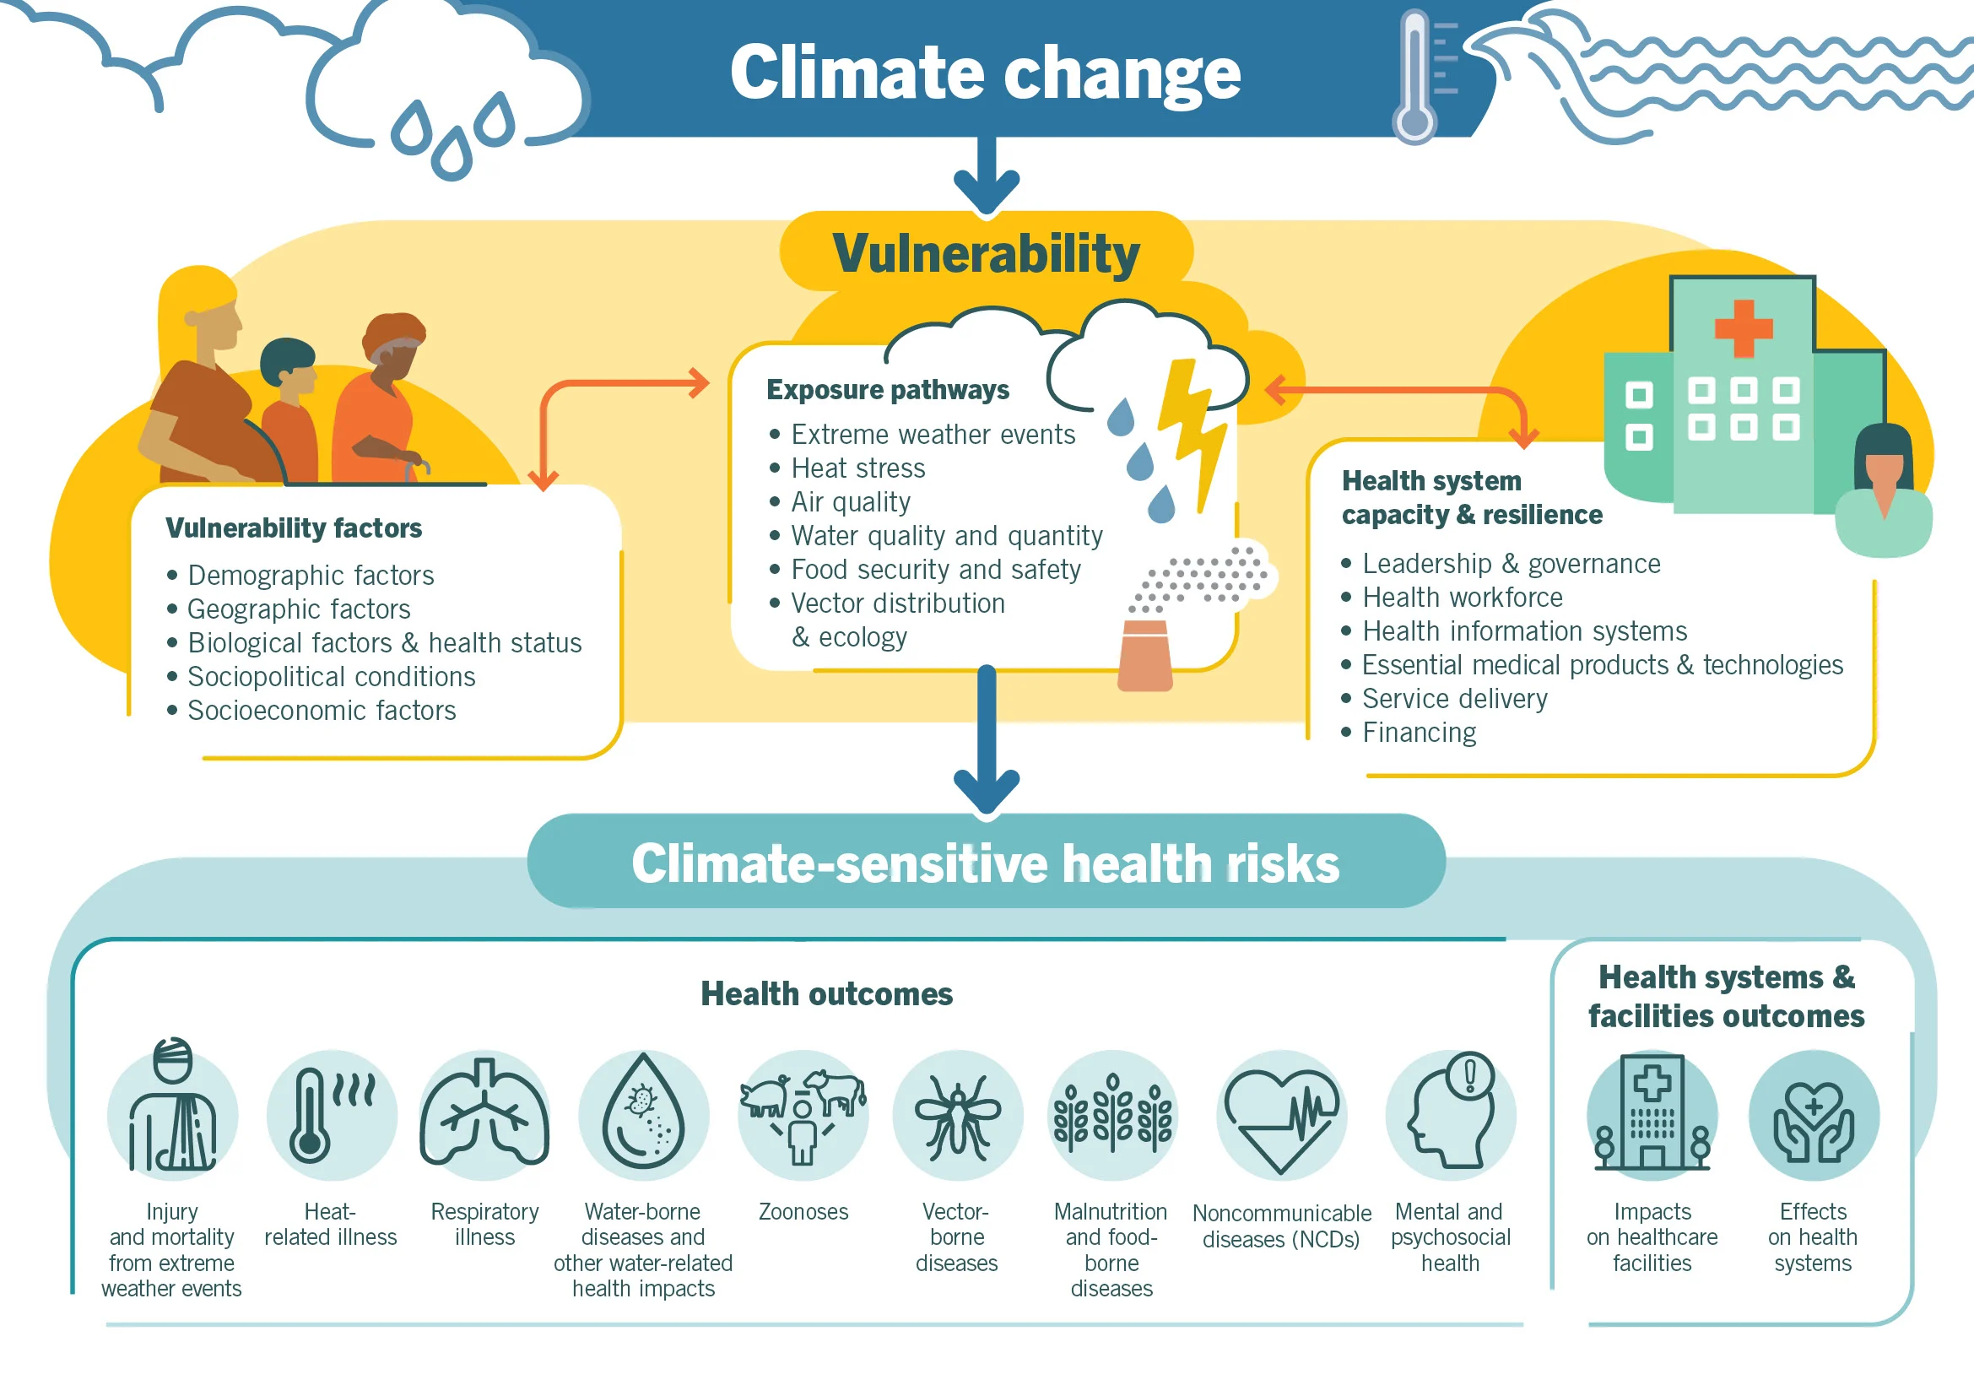

Slide 14
What are the effects of climate change in your area?
Make groups on countries/cities/villages
Tell us:
Where are you from?
Describe the area where you are living
What effects of the climate change you have observed in your area

Slide 15
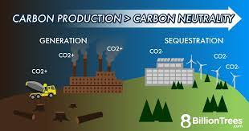
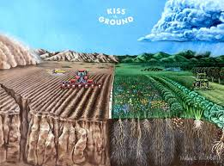
Can we slow or even reverse global warming?
YES, we can!

Slide 16


What can you do to reduce climate change?
https://www.youtube.com/watch?v=EtW2rrLHs08
Divide into groups and talk about:
What can you reduce?
What do you reuse?
What do you recycle?
You need to do lists
That we will compare
With other groups
You need to have representatives from all countries in the group.

Slide 17
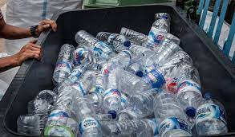
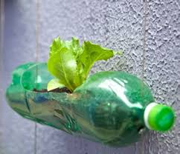


The life of a plastic bottle
https://www.youtube.com/watch?v=_6xlNyWPpB8
Is it ok to just recycle plastic bottles?

Slide 18
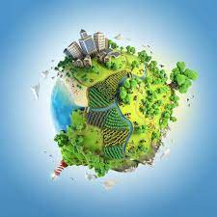
What about a greener planet - Agenda 2030
Agenda 2030 is a plan of action for people, planet and prosperity. It also seeks to strengthen universal peace in larger freedom.
The Sustainable Development Goals (SDGs), also known as the Global Goals, were adopted by the United Nations in 2015 as a universal call to action to end poverty, protect the planet, and ensure that by 2030 all people enjoy peace and prosperity.
The 17 SDGs are integrated—they recognize that action in one area will affect outcomes in others, and that development must balance social, economic and environmental sustainability.

Slide 19
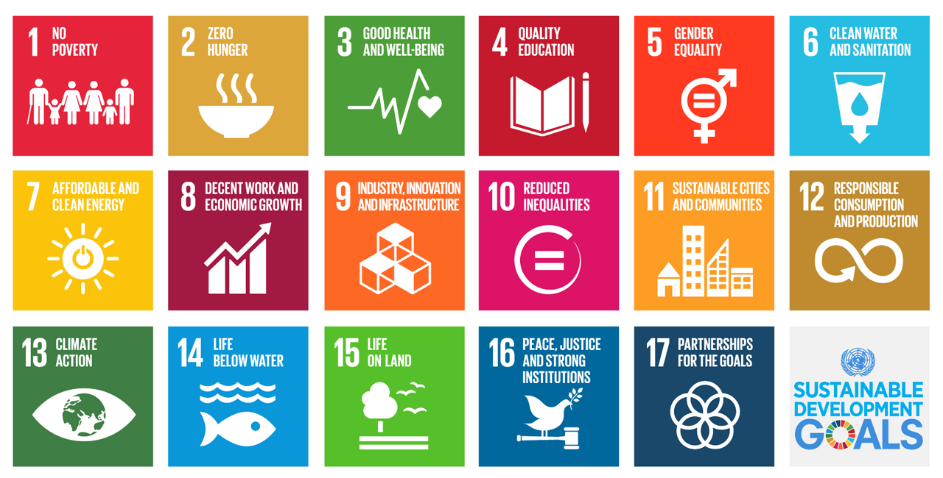

Slide 20
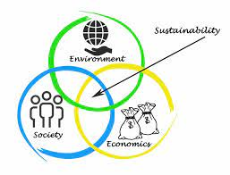
Sustainable cities and villages.
What do you need to build them?
Divide into groups and make the plan for sustainable city or village.
Talk about that and then draw the plan on paper.
Land and planning
Ecohouses and buildings
Sustainable energy sources
Sustainable food….

